Slide 1
K-NN Classification algorithm
How it works and how we implement

Slide 2
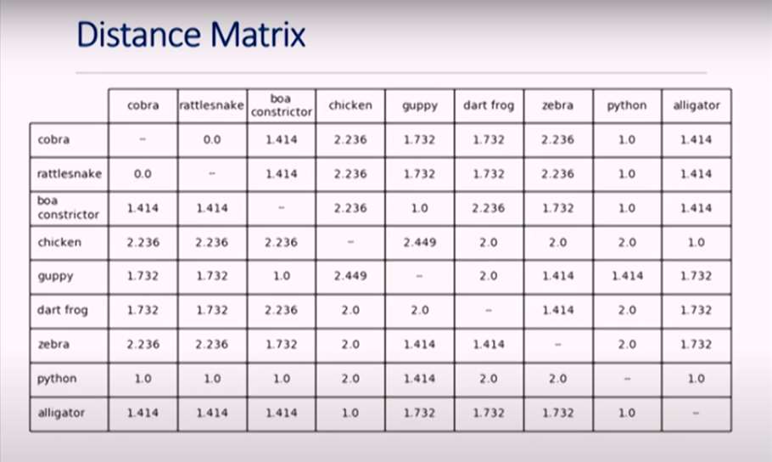

Slide 3
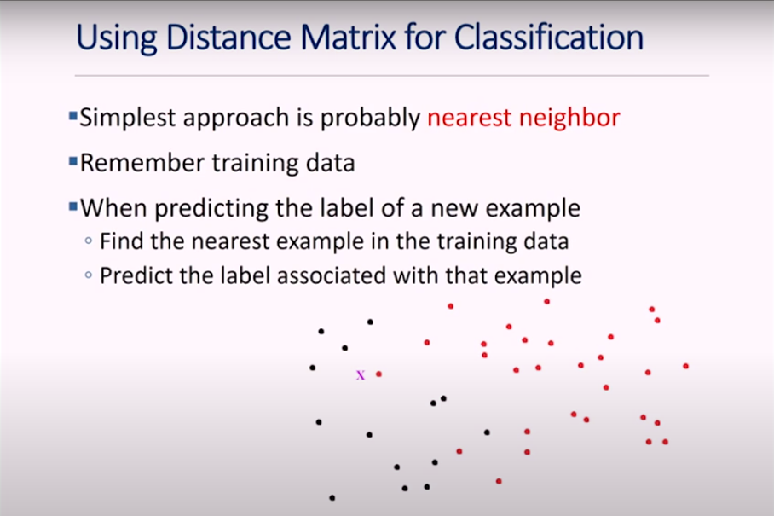
How we classify the features when we get the new data as an input .
The machine remembers the training data. To predict the label of new data, it finds the nearest feature in the training set and chooses the label associated with that feature.

Slide 4
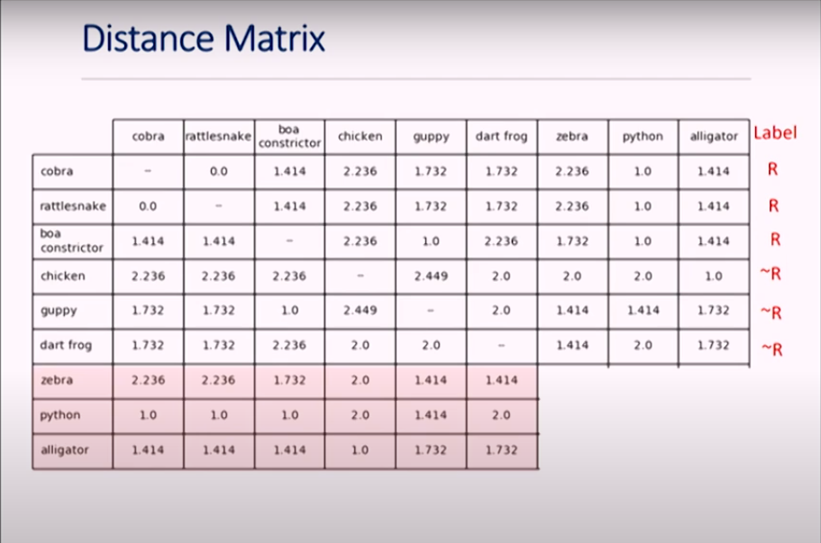
We will classify the shaded animals as Reptiles or Not Reptile( Label )
Using distance matrix ( which is the sole concept of nearest neighbor )

Slide 5
Lets take Zebra
Zebra is close to ‘guppy’ and ‘dart frog’.
when we see guppy and dart frog’s label its is classified as Not Reptile so we can classify zebra as Not Reptile
Now lets take alligator
Alligator is close to ‘chicken’.
when we see chicken’s label is classified as Not Reptile so we now will classify alligator as Not Reptile.( which is Wrong )

Slide 6
What went wrong ?

Slide 7
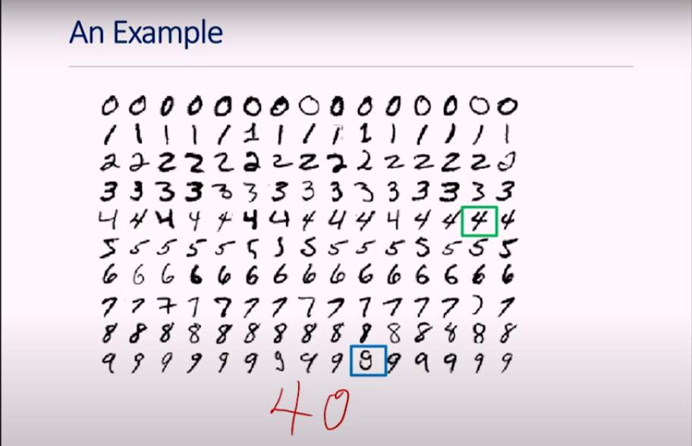
When we write 40 ( handwritten )
It will map 4 to 4 in the dataset image and 0 to 9 in the dataset( it is not necessary that it will map to that 9 but
as that particular 9 in the dataset is looking like a 0, it will map to that saying it is the nearest neighbour)
This is actually a noise( like outliers etc..)

Slide 8
How to overcome this problem ?

Slide 9
There comes the role of K-NN(k- nearest neighbour)

Slide 10
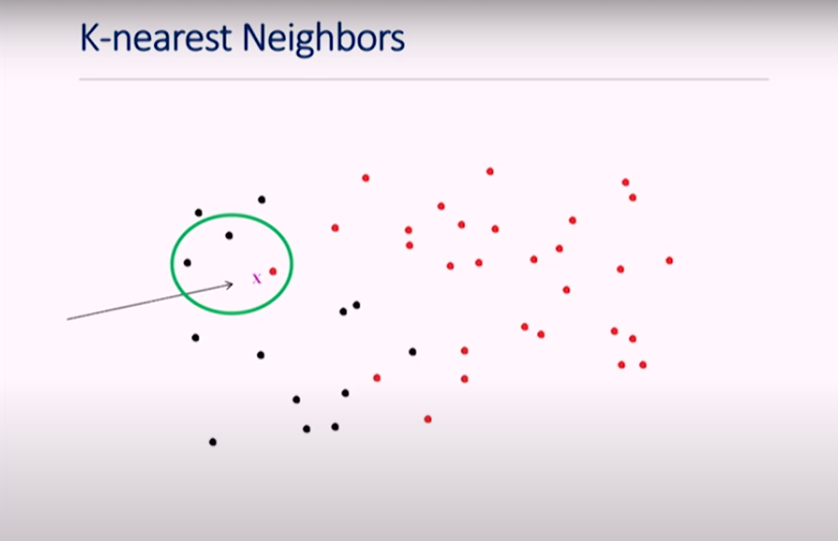
K-NN
Basic Idea here is we don’t just take the nearest neighbour, we take some number of nearest neighbour usually odd numbers and we just let them vote.
Now we want to classify this feature X with K as 3.
As we can see we have 2 black and 1 red are the 3-nearest neighbour of X, so based on this we can classify X as black
Here we can see red which is nearer to X is a noise(outlier) so by introducing K-NN we didn't let outliers to dominate.

Slide 11
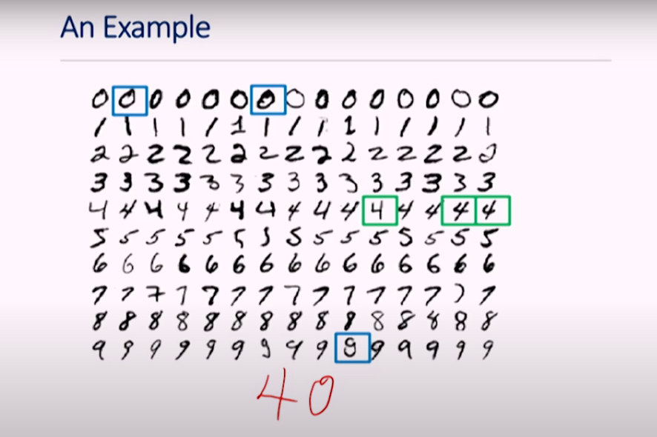
So when we take K = 3 then classification look soothing like this

Slide 12
How we choose K value.
We take our dataset and we split it into 2 parts training and testing, again we take this training data and split into 2 and so on. Each set will be experimented with different Ks and finally check which k will gives us the best result. And that becomes our ‘K’
This is called cross-validation( this is most commonly used to choose the parameter in ML )

Slide 13
How we test our classifiers
There are 2 different methods:
Leave one out class of testing – when we have small number of data samples in dataset. In this we take all ‘n’ data samples and remove one of them, train on n-1 and test on 1. we put that one back and remove another one, likewise we do on each element of the data and then average the results.
Repeated random subsampling – we do this on larger set of data, we split our data 80-20 or 70-30 and we will test using appropriate metrics(discussed in next slide) based on dataset and output.

Slide 14
When ever there is imbalance of features in the dataset the accuracy may not be the perfect matrix to evaluate the model so we will go for other metrics.
Sensitivity(Recall) – how good is it in identifying positive cases(in this case died)
Specificity(Precision) - how well a model identifies negative cases correctly(the person did not die).
Positive predictive value – Of all predicted positive cases, how many were actually positive.
Negative predictive value – Of all predicted negative cases, how many were actually negative.

